Slide 1
Accessible, inclusive education: a moral and legal imperative
Susan Aldridge, Drexel University Online
Sharon Krevor-Weisbaum, Brown Goldstein Levy
Scott Ready, Blackboard

Slide 2
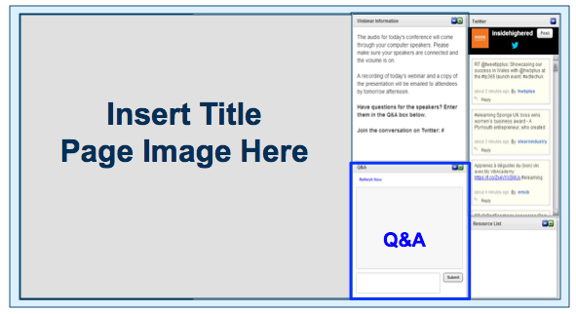

Before We Begin
We are using On24 for today’s webinar. Please enter questions in the text field at the bottom of the Q&A Window. We are monitoring the discussion and will try to bring the Q&A comments into the conversation.
We are recording the webinar; the webinar archive and slides will be available tomorrow.

Slide 3
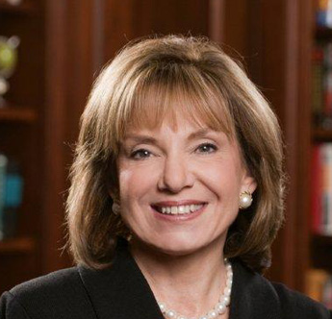
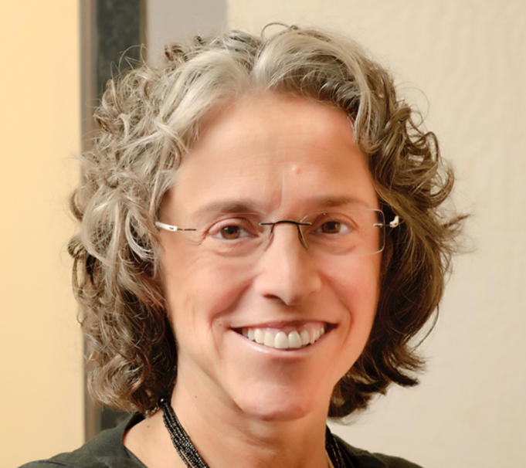

Speakers
Dr. Susan Aldridge
President,
Drexel University Online
Sharon Krevor-Weisbaum, Esq. Managing Partner,
Brown Goldstein Levy
Scott Ready
Principal Consultant, Blackboard

Slide 4

We will take a look at
The current state of accessibility regulations and compliance in Higher Education
How quality and compliance combine at Drexel to improve online learning
How Blackboard assists institutions to improve accessibility and inclusive education
Next steps in accessibility and compliance for Higher Education

Slide 5
Awareness of the civil rights of
the learner
Proactively building programs to avoid
Accessibility Litigation
Current Trends in Accessibility: Higher Ed
Higher expectations for
product accessibility
Mindset shifting towards inclusion
Lower number of students disclosing disabilities
Notes:
Higher Education
With 12.9% of all students in North America having some form of disability, awareness of the civil rights of these students is increasing. The expectations around content and platform accessibility are growing as well as schools work to tackle accessibility in their courses.
This proactivity is partly driven by an increased risk of litigation and has prompted many institutions to act now, the University of Montana previously mentioned being an example.
Lastly, most students choose not to disclose their disability when they enter higher education. That's 60 to 80% of North American undergrads and 9% of graduate students. As mindsets shift towards that of inclusion, greater strides can be made to reach those students that have not disclosed.
These trends force many organizations to rethink their approach when it comes to products and content and Blackboard is good example.

Slide 6
Institutional Challenges
No insight into how institution is doing
Difficult to track and identify what to focus on
Manual remediation workflow
Lawsuits because of legal requirements

Slide 7

Instructor Challenges
Lack of awareness of what to do
Lack of understanding on how it can affect students
Lack of guidance on how to improve accessibility

Slide 8

Student Challenges
Explicit alternative format requests
Long delays on receiving requested format
Excludes many students
Closely related to quality and usability

Slide 9
CIO Assessments of Digital Resources and
Services for Disables Users, Fall 2014-2016
percentage reporting “excellent” (6/7)
scale: 1=poor; 7= excellent;
Source: Green, The Campus Computing Project
campuscomputing.net

Slide 10
[Poll] What’s your current situation?
WHO – which individual or unit – is responsible for digital accessibility and ADA
compliance in your instructional programs, resources, and services?
Response options
No clear institutional policy or procedure
Individual faculty, for their own courses
Individual departments and units, for their own courses & programs
A central office provides review and support services
Other

Slide 11
Legal actions take different forms: an openness to discussion and negotiation, litigation or federal enforcement

Slide 12

Legal Landscape
June 29, 2010: Letter issued by the Department of Justice and the United States Department of Education to College and University Presidents:
The letter confirmed that requiring use of an emerging technology (an inaccessible book reader) is discrimination prohibited by the ADA and Section 504 unless accommodations or modifications can be provided that permit the student with a disability to receive all the educational benefits provided by the technology in an equally effective and equally integrated manner.

Slide 13
June 29, 2010, continued: Letter issued by the Department of Justice and the United States Department of Education to College and University Presidents:
Legal Landscape
The letter reminded private college and university presidents that Under Title III, students with disabilities may not be discriminated against in the full and equal enjoyment of all of the goods and services of the college or university; students must receive an equal opportunity to participate in and benefit from these goods and services; that students must not be provided with different or separate goods or services unless doing so is necessary to ensure that access to the goods and services is equally effective as that provided to others.
The letter reminded public university presidents that under Title II qualified individuals with disabilities may not be excluded from participation in or denied the benefits of the services, programs or activities of, nor subjected to discrimination by the public university or college.
The letter went on to confirm that both Title II and Section 504 prohibit public colleges/universities from affording individuals with disabilities with an opportunity to participate in or benefit from college and university aids, benefits, and services that is unequal to the opportunity afforded others. And, that, individuals with disabilities must be provided with aids, benefits, or services that provide an equal opportunity to achieve the same result or the same level of achievement as others.

Slide 14

Legal Landscape: June 29, 2010
DOJ told college and university presidents to refrain from requiring the use of inaccessible book reader, or other technology, in a teaching or classroom environment, as long as the device remains inaccessible. DOJ states that “it is unacceptable for universities to use emerging technology without insisting that this technology be accessible to all students.”
U.S. Dept. of Justice Joint Dear Colleague Letter:
Electronic Book Readers (6/29/2010):
http://www2.ed.gov/about/offices/list/ocr/letters/colleague-20100629.html
“Technology is the hallmark of the future, and technological competency is essential to preparing all students for future success. Emerging technologies are an educational resource that enhances learning for everyone, and perhaps especially for students with disabilities. Technological innovations have opened a virtual world of commerce, information, and education to many individuals with disabilities for whom access to the physical world remains challenging. Ensuring equal access to emerging technology in university and college classrooms is a means to the goal of full integration and equal educational opportunity for this nation’s students with disabilities. With technological advances, procuring electronic book readers that are accessible should be neither costly nor difficult.”

Slide 15

The United States Department of Education, Office for Civil Rights issued a “Frequently Asked Questions” document about the June 29, 2010 Dear Colleague Letter.1
Legal Landscape: May 26, 2011
The FAQ made clear that none of what it said in the June 29, 2010 letter was new law but rather addressed key principles of federal discrimination law.
The FAQ explained that the test for compliance is the functional definition of accessibility reiterated in the Dear Colleague Letter: one can acquire the same information, engage in the same interactions, and enjoy the same services as sighted students with substantially equivalent ease of use. And, even if this does not result in identical ease of use, it must ensure equal access to the educational benefits and opportunities afforded by the technology and equal treatment in the use of such technology.
This same test applies to those with other print disabilities.
One purpose of the Dear Colleague letter was to remind universities of its obligations when purchasing emerging technologies.
The Dear Colleague Letter applies to all school operations, including pilot programs and to all faculty and staff.

Slide 16
Legal Landscape: May 26, 2011, continued
Confirmation that the Letter applies to all school programs, whether in brick and mortar, online (provided by the school or through contractual or other arrangement) or other virtual context.
Clear message that schools must plan for having accessible technology available immediately upon a request; “the planning should include identification of a means to provide immediate delivery of accessible devices or other technology necessary to ensure accessibility from the outset.”
Must consider accessibility when they are deciding whether to create or acquire emerging technology, and when they are planning how the technology will be used. Accessibility must be part of acquisition procedures.
Questions that must be asked: What educational opportunities and benefits does the school provide through the use of the technology? How does the technology provide these opportunities and benefits? Does the technology exist in a format that is accessible to individuals with disabilities? If the technology is not accessible, can it be modified, or is there a different technological device available, so that students with disabilities can obtain the educational opportunities and benefits in a timely, equally effective, and equally integrated manner?
U.S. Dept. of Justice FAQ re: Dear Colleague Letter: Electronic Book Readers (5/26/2011): http://www2.ed.gov/about/offices/list/ocr/docs/dcl-ebook-faq-201105.html

Slide 17
Definitions
“Accessible” means that individuals with disabilities are able to independently acquire the same information, engage in the same interactions, and enjoy the same services within the same timeframe as non-disabled individuals, with substantially equivalent ease of use.
“Accessibility Standards”
    WCAG 2.0 AA and WAI-ARIA 1.0 for web content;
    ATAG 2.0 for software used to create web content;
    UAAG 1.0 for web browsers, media players and assistive technologies;
    WCAG2ICT for non-web software and content;
    MATHML 3.0 specifications for digital mathematical and scientific notation;
    DAISY or ePub3 for digital publications and documents;
    BANA Guidelines and Standards for Tactile Graphics (2010) and Guidelines for the Production of Braille Materials through the Use of Braille Production Software (2007) for hardcopy Braille; and
    ADAAG and other standards for the accessible design of kiosks, ATMs personal computers, and other campus or classroom technology.

Slide 18
Road Map
Accessibility Policy
Grievance Process
Accessibility Coordinator
Training
Internal Accessibility Audit
Technology Instructional Materials
Corrective Action Strategy Plan
Procurement

Slide 19

Accessibility Audit of Electronic Information Technology (“EIT”) that will examine the accessibility and usability of the EITs provided to students, prospective students, staff and faculty. The audit shall examine various aspects of the University’s EIT, including but not limited to, University websites, application processes, library services, course management systems, access to classroom podiums and LCD devices, course registration software, personal response systems (“clickers”) and banking arrangements, offered to students and faculty, including website and ATM access.
Based on results of audit, development of an EIT corrective action strategy with time lines for completion. The strategy and time line shall be posted.
Creation of an Accessibility Policy Statement with procedures for implementation, dissemination and training.
Designation of University Accessibility Policy Monitor, with commensurate authority.
Campus-wide Accessibility Committee
Grievance Procedures

Slide 20

Road Map
Procurement procedures must require that the University purchase or recommend only EITs that will provide the same programs, benefits and services that they do to individuals without disabilities, except that when it is technically unfeasible to do so, the procedures must require the provision of accessible alternate EITs.
RFP language shall include that bidders meet the accessibility standards of WCAG 2.0 Level AA for web-based technology, and Section 508 and the ADA for other EIT.

Slide 21
BGL HIGHER EDUCATION SETTLEMENTS
CASE | LINK | YEAR | CLIENT(S)
National Federation of the Blind, American Council of the Blind, & the United States of America, et al. v. Arizona State Board Regents, et al. (United States District Court for the District of Arizona, No. CV09--1359) | https://www.ada.gov/arizona_state_university.htm | 2010 | National Federation of the Blind
The Pennsylvania State University (U.S. Dept. of Educ. OCR #03-11-2020) | http://accessibility.psu.edu/nfbpsusettlement/ | 2011 | National Federation of the Blind
Wichita State University (U.S. Dep. of Educ. OCR # 07162056) | https://nfb.org/images/nfb/documents/pdf/higher-ed-toolkit/wichita-state-agreement.pdf | 2011 | Emily Schlenker & National Federation of the Blind
Toth, et al. v. Florida State University Board of Trustees (U.S. District Court for the Northern District of Florida, No. 11-CV-00317) | https://nfb.org/images/nfb/documents/pdf/fsu%20settlement%20agreement.pdf | 2012 | Plaintiffs Christopher Toth & Jamie Principato
University of Montana-Missoula (U.S. Dept. of Educ., OCR # 10122118) | https://athenpro.org/sites/default/files/Univ_Montana_Missoula_FinalAgreement10_2014.pdf | 2014 | National Federation of the Blind & individual Student from Montana
Ibanez, et al. v. Maricopa Community College District, et al . (U.S. District Court, District of Arizona, CV 12-907- PHX-NVW) | https://nfb.org/images/nfb/documents/pdf/higher-ed-toolkit/mcccd_nfb_settlement_agreement.pd | 2014 | Sebastian Ibanez & National Federation of the Blind
Lanzilotti, et al. v. Atlantic Cape Community College (U.S. District Court for the District of New Jersey, Case No. CV 15-3656) | http://www.atlantic.edu/documents/NFB_Lanzailotti-%20Executed_FiledConsentDecree(100810556_1)-4.pdf | 2015 | Anthony Lanzilotti, Mitchell Cossaboon & National Federation of the Blind
Aleeha Dudley v. Miami University (U.S. District Court for the Southern District of Ohio, No. 14-cv-38) | http://www.disabilityrightsohio.org/assets/documents/dudley_final_settlement_agreement.pdf | 2016 | Aleeha Dudley
Aleeha Dudley & United States of America v. Miami University (U.S. District Court for the Southern District of Ohio, No. 14-cv-38) | http://www.disabilityrightsohio.org/assets/documents/dudley_consent_decree_10-17-16.pdf | 2016 | Aleeha Dudley
National Federation of the Blind and Southern Oregon University (U.S. Dept. of Educ., OCR # 10162040) | https://nfb.org/images/nfb/documents/pdf/higher-ed-toolkit/sou-agreement.pdf | 2017 | National Federation of the Blind

Slide 22
How is Drexel University Online addressing this challenge?
Notes:
DARCY and SUSAN

Slide 23
Instructional
Design
Student Outcomes and Satisfaction
Faculty/SME Engagement
Appropriate Use of Technology

Slide 24

Benefits of quality, accessible online design
Consistent Student Experience
Expanded Opportunities
for Collaboration
Efficiencies in Faculty Time
Quality Assurance
Across Online Programs

Slide 25
Quality Rubrics should include:
Course Design:
Goals and Objectives
Content Presentation
Learner Engagement
Technology Use
Interaction and Collaboration:
Communication Strategies
Development of Learning Community
Interaction Logistics
Assessment:
Expectations
Assessment Design
Self-Assessment
Learner Support:
Orientation to Course and LMS
Supportive Technologies
Instructor Role and Information
Course/Institutional Policies and Support
Technical Accessibility Issues
Accommodations for Disabilities
Feedback

Slide 26
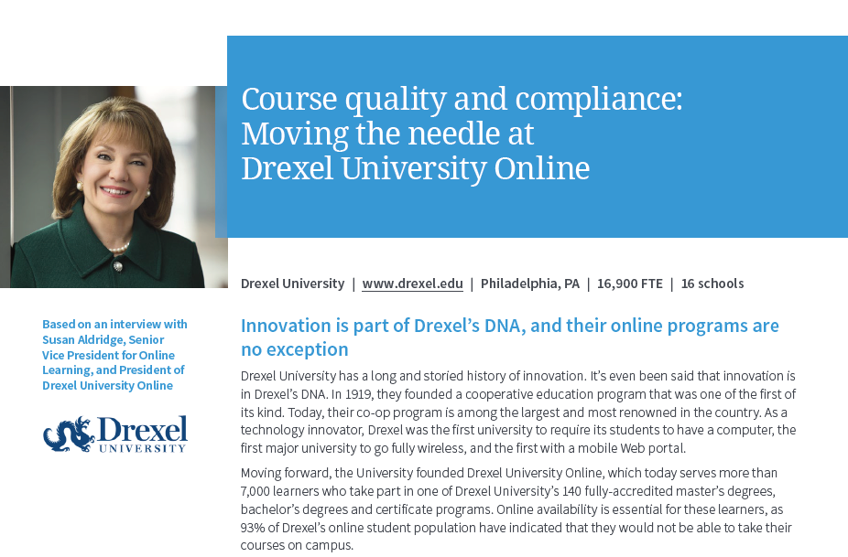
Course quality and compliance:
Moving the needle at
Drexel University Online

Slide 27
[Poll] How do you define Accessibility?
How does your institution think about accessibility?
Response options
Special accommodations only for students who request them
Tools that can improve a course, but used only as required or time permits
An inclusive education that benefits all learners
Other

Slide 28
What do we mean by inclusive education?

Slide 29
Laws That Dictate Accessibility
United States Access Board : Section 504 and 508 of the Rehabilitation Act of 1973 - Electronic and Information Technology Accessibility Standards
ADA (Americans with Disabilities Act) of 1990
IDEA (Individuals with Disabilities Education Act) - Former Public Law 94-142
Assistive Technologies Act
OCR (Office of Civil Rights) rulings

Slide 30
The regulation requires a public entity, such as a state university, to take appropriate steps to ensure that communications with persons with disabilities are as effective as communications with others. Thus, the issue is not whether the student with the disability is merely provided access, but the issue is rather the extent to which the communication is actually as effective as that provided to others.
DOE OCR Letter to San Jose State - http://www.icdri.org/legal/sjsu.htm

Slide 31


Encouraging Inclusive Environments for all
Rethink how learning is achieved and provide the means to help students succeed.
With increased attention being placed on inclusive environments and equal opportunity to access to information for everyone, it is important to understand the diverse needs your learners may have.
Revisit content and ensure it’s set up for universal consumption
Understand how people need to interact with different tools you are using and adjust

Slide 32
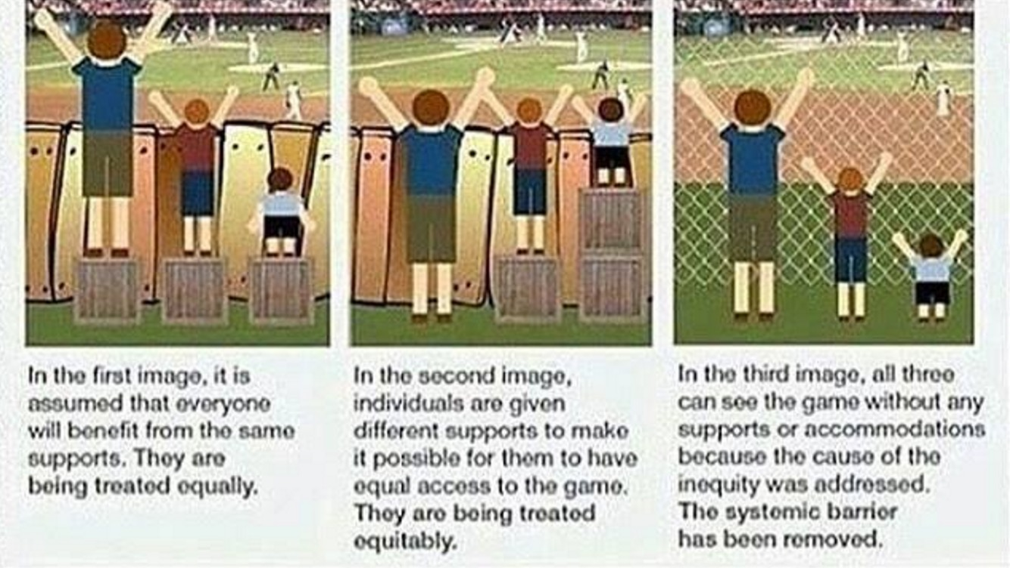
Removing barriers

Slide 33
“Institutions that have an accessibility policy and dedicated resources, and who are acting in good faith, are less likely to be sued. Institutions that are not implementing policy are vulnerable.”
Eve Hill, Esq., Partner, Brown Goldstein Levy
[Former Deputy Assistant Attorney General for Civil Rights at the U.S. Department of Justice]

Slide 34
eLearning Accessibility Plan
The solution is designed to identify operational barriers and provide remediation approaches within a variety of functions related to the eLearning student lifecycle. This solution results in a comprehensive accessibility operational plan to provide a barrier-free eLearning experience for individuals with disabilities.
Review of academic & student services
Operational Accessibility Plan
Goals, strategies, metrics, and tools for improvement
The plan will not address physical accessibility barriers on the institution’s campus nor are the recommendations a substitute for legal counsel.

Slide 35
Create a strategic plan for accessibility (and enforce it)
Faculty Development (beyond the technology)
Qualified Instructional Designers
Design and Development Processes and Procedures
Ongoing Reviews and Maintenance

Slide 36



eLearning Accessibility Course Audit
The solution is designed to identify barriers within eLearning courses. This solution results in course and institutional level reporting of barriers along with recommended remediation approaches. Targeted course creation training is included to provide a barrier-free eLearning experience for individuals with disabilities.
Audit of eLearning courses
Analysis and reports on barriers in courses
Training on inclusive course creation
It is worthy to note that these findings and recommendations are not a substitute for legal counsel.

Slide 37
Simple First Steps to Making Content Accessible
Use descriptive headings to
organize content
Don’t use font styles alone to
indicate importance
Add alternative (alt) text to images
Make links descriptive
Use lists over tables when possible
Include descriptive captions to videos
Format files to be accessible
Tag PDF files
Provide students clear expectations, instructions, and direction for all assignments and tests

Slide 38
For more information…
Blackboard Accessibility Imperative eLearning Accessibility Planning
Drexel University Online case study
Global Accessibility Awareness Day webinar series – May 18, 2017

Slide 39
Additional Resources:
Higher Education Accessibility Resource Center
https://nfb.org/higher-education-accessibility-online-resource-center
California State Accessible Technology Initiative:
http://www.calstate.edu/accessibility/
University of California Electronic Accessibility Policy:
http://www.ucop.edu/electronic-accessibility/initiative/policy.html
The Ohio State University Web Accessibility Policy:
http://ada.osu.edu/resources/webaccessibilitypolicy.pdf
Temple University policies:
https://temple.edu/about/temple-university-accessibility-statement
University of Minnesota Accessibility Policy:
http://accessibility.umn.edu/umn-policies.html

Slide 40
Contact Information
Dr. Susan Aldridge
President,
Drexel University Online
sca39@drexel.edu
Sharon Krevor-Weisbaum, Esq. Managing Partner,
Brown Goldstein Levy
skw@browngold.com
Scott Ready
Principal Consultant, Blackboard
scott.ready@blackboard.com

Slide 41
Questions?

Slide 42

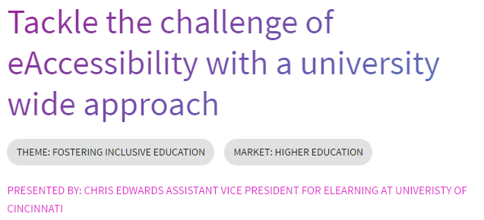
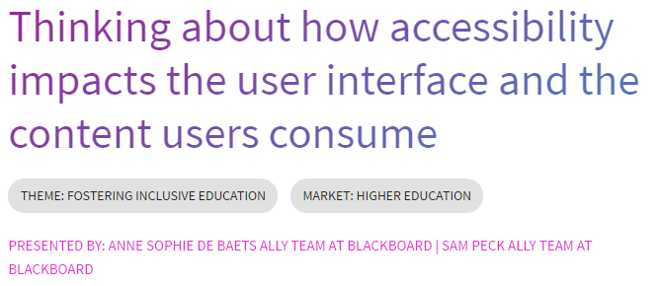
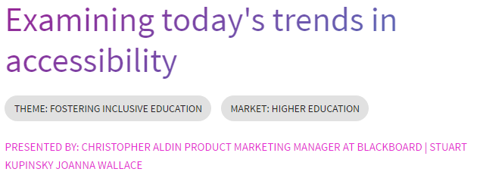
BbWorld Sessions are posted – We have an accessibility track! http://bbworld.com/bbworld/sessions/
Filter by theme, “Fostering Inclusive Education”

